Slide 1
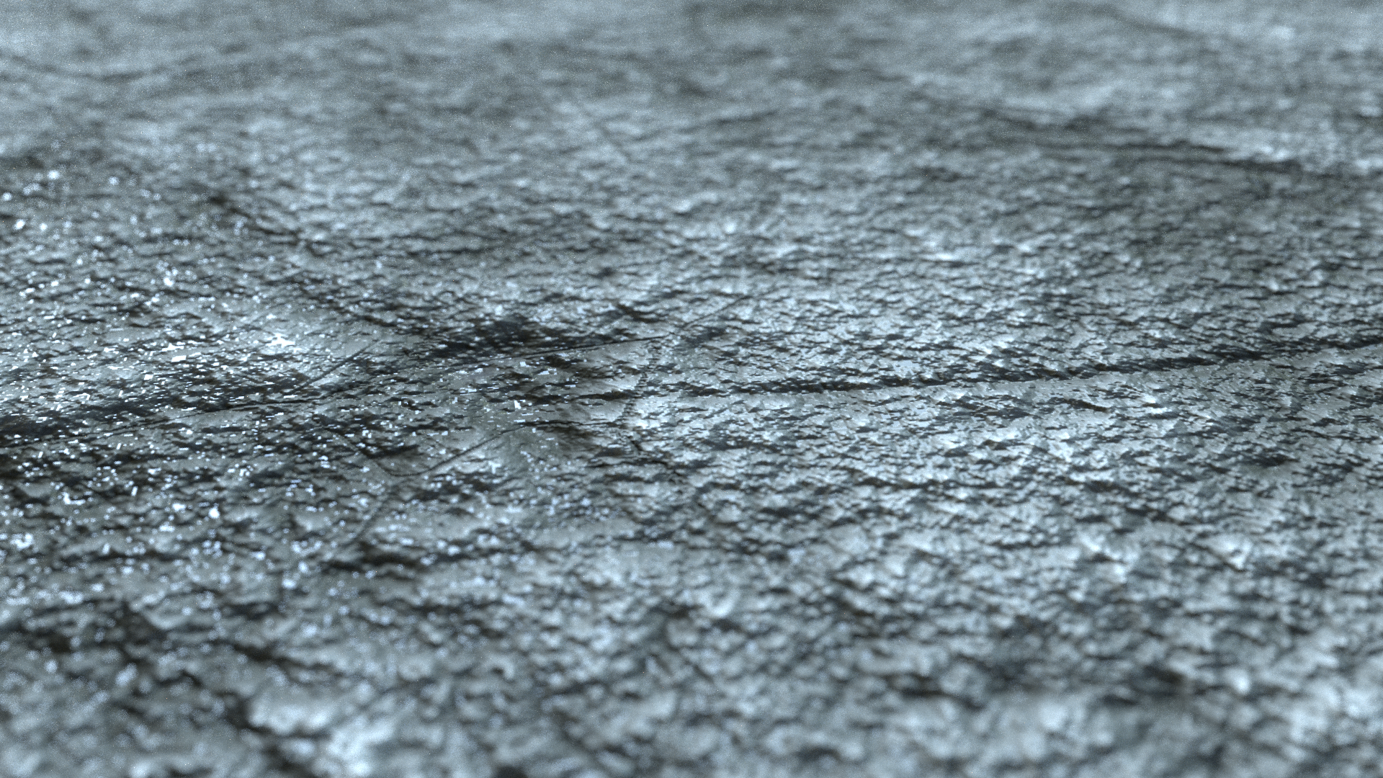
Material Designer
Online Texture Delivering System
Lasantha M Senanayake
S/15/418

Slide 2
What is Material Designer?

Slide 3
Material Designer
System
Material Designer
Editor
Material Designer
Website
Material Designer
Content Delivery System

Slide 4

Material Designer
Editor
Material Designer
Website
Material Designer
Content Delivery System
Material Designer
Server

Slide 5
Material Designer
Editor
The idea is to create a software that generate textures using mathematical functions eg – Perlin Noise
let imge = perlin_noise( ,
)
255
1
2
3
4
5
6
7
8
9

Slide 6
Material Designer
Editor
eg2 – Brick Generator
let imge = brick_generator( ,
imge
255
)
6
let blur = gaussian_blur( , (5, 5))
return blur

Slide 7
Material Designer
Editor
brick_generator
6
gaussian_blur
5
5
let imge = brick_generator( ,
)
255
6
let blur = gaussian_blur( image , (5, 5))
{
functions: [“ ”, “ ”],
data: {
seedBrickGenerator: ,
kernelGaussian: [ , ]
}
}
return blur

Slide 8
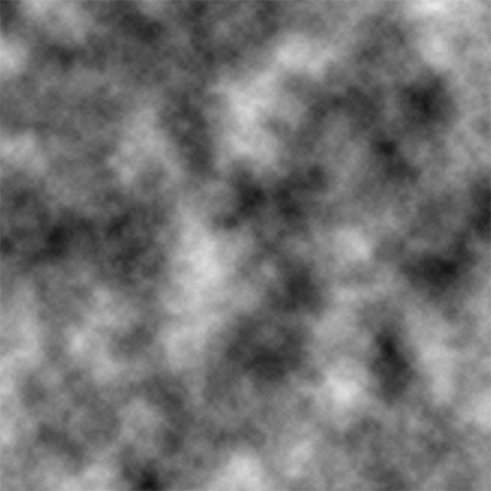
Material Designer
Server
22kb
2,245kb

Slide 9
Material Designer
Server
Okay got it
Here it is
Hey server, save this brick_texture.json
Hey server, can I have brick_texture.json
Material Designer
Editor
Material Designer
Content Delivery System

Slide 10
The website where game developers / architecture visualizers or graphic designers can share preview or sell there texture designs created using, Material designer Editor
What is Material Designer Web?

Slide 11
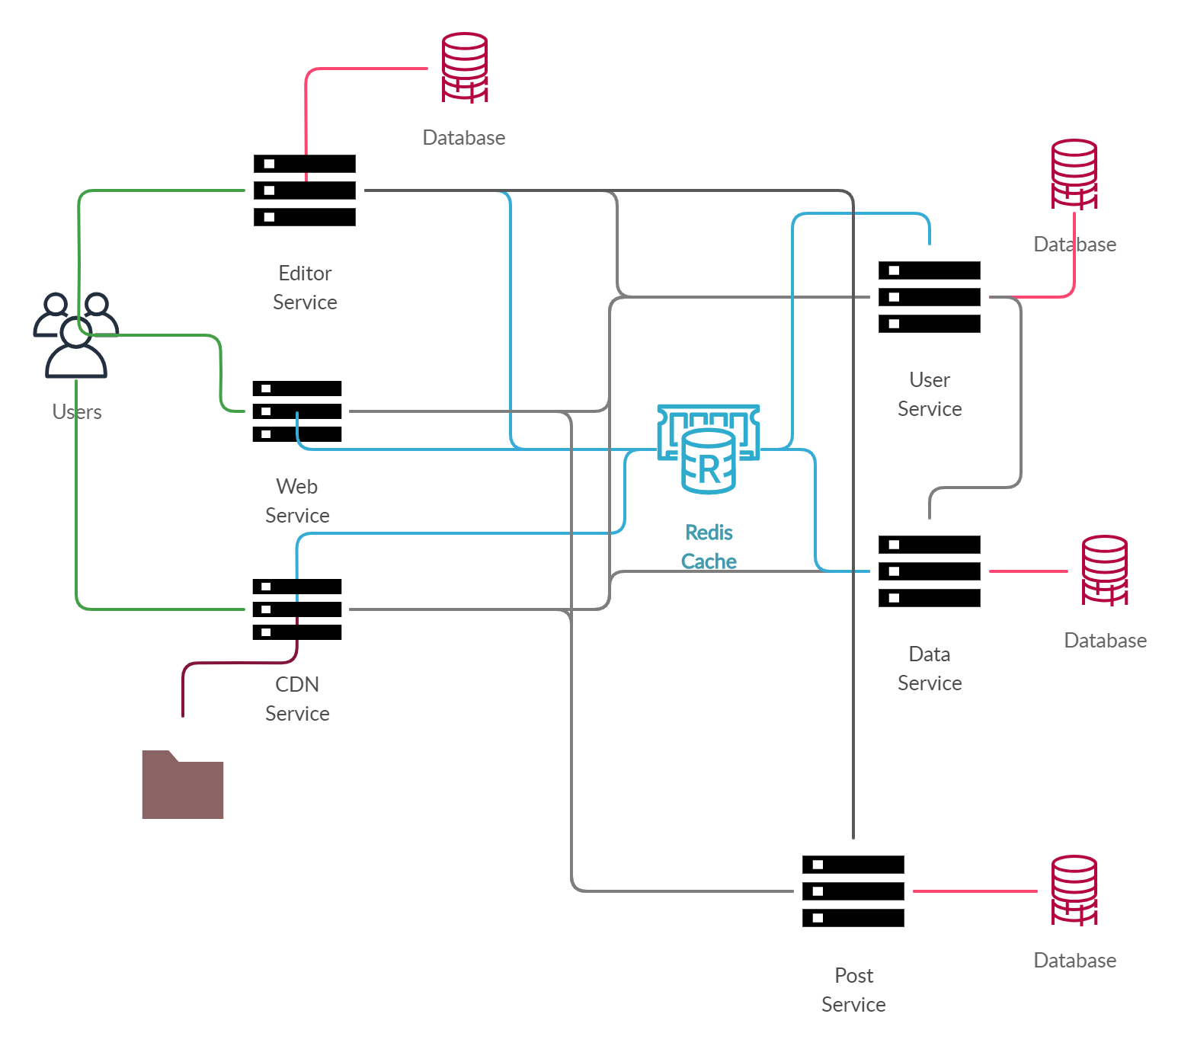

Slide 12
Technologies Used

Slide 13
Material Designer Server

Slide 14



Slide 15









Slide 16
Material Designer Web

Slide 17



Slide 18
Material Designer Editor

Slide 19




Slide 20
Advantages of Material Designer
Can use as a lightweight texture transfer method instead of transferring pixel texture data
Can push live updates to a game instead of sending huge patches.
Can use as an online repository to keep your creations artwork online.

